Slide 1
Deque in Python
DVT101 – Lecture 32
- By Dataverse Tutorials

Slide 2
What is Deque?
Meaning of double-ended queue
Difference from list and queue
Insert/remove from both ends
Why it is special

Slide 3
Why Do We Need Deque?
O(1) operations at both ends
Faster than list for front operations
Supports FIFO and LIFO
Real-time data handling

Slide 4
Where Deque is Used
Task scheduling systems
Sliding window problems
Real-time log processing
Caching mechanisms

Slide 5
Internal Working of Deque
Doubly linked blocks concept
Constant time insert/delete
Memory block chaining
Comparison with list memory

Slide 6
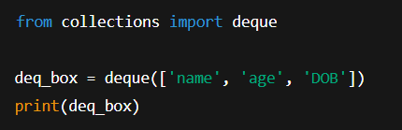
Creating a Deque
Using collections module
Initializing with iterable
Visualizing left and right ends
Dynamic resizing behavior

Slide 7
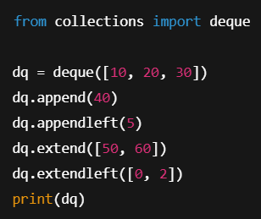
Adding Elements
append to right
appendleft to left
extend from iterable
extendleft logic

Slide 8
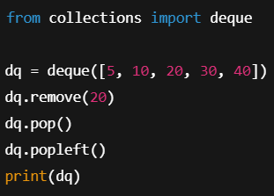
Removing Elements
pop from right
popleft from left
remove by value
clear all elements

Slide 9
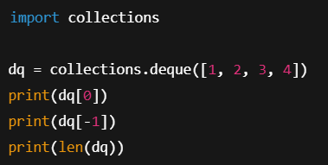
Accessing & Length
Indexing support
Negative indexing
Using len function
Boundary safety

Slide 10
Counting & Searching
count occurrences
index position logic
Handling missing values

Slide 11
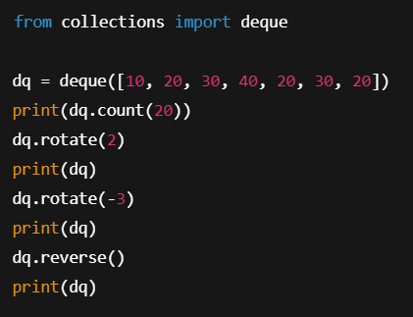
Rotation & Reversal
rotate right
rotate left
reverse order
Circular buffer behavior

Slide 12
Restricted Deque Types
Input restricted deque
Output restricted deque
Use-case differences

Slide 13
Performance & Time Complexity
O(1) vs O(n) operations
When deque is faster than list
Memory trade-offs

Slide 14
Deque vs List vs Stack
Operation speed
Memory efficiency
Use-case suitability

Slide 15
Real-World Industry Use
OS task queues
Network packet buffers
Sliding window analytics

Slide 16
Common Mistakes
Using list instead of deque
Confusing append and appendleft
Removing wrong side

Slide 17
Best Practices
Use for front-heavy operations
Avoid random access heavy logic
Combine with maxlen

Slide 18
Career Relevance
Data structures interviews
Backend pipelines
ML data streams

Slide 19
Limitations of Deque
Slower random access
Not thread-safe
No slicing support

Slide 20
When NOT to Use Deque
Heavy indexing tasks
Sorting requirements
Static datasets

Slide 21
Summary & Key Takeaways
Double-ended flexibility
High performance
Ideal for queues & stacks

Slide 22


